Slide 1
MEDASSIST AI:
AI Medical Symptom Analysis & Disease Prediction System
Milestone 2 Progress
Name: Amrutha M
Branch: CSE - AIML
Internship: Infosys Virtual Internship 7.0

Slide 2
Objective:
The main objective of Milestone 2 was to build a working healthcare web application that can: predict diseases from patient symptoms, store patient information, generate medical reports, manage appointments, and help healthcare providers monitor patients.

Slide 3
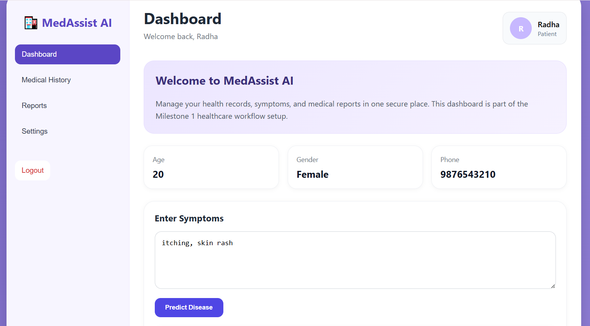
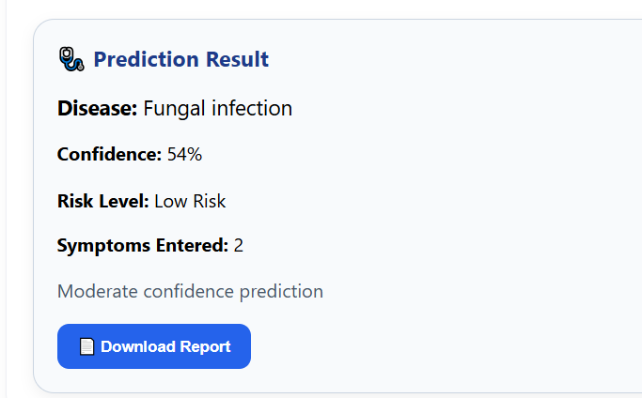
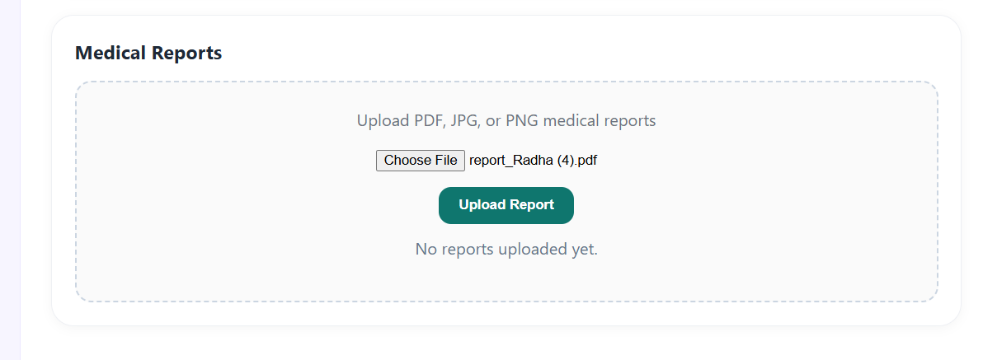
Patient Dashboard

Slide 4
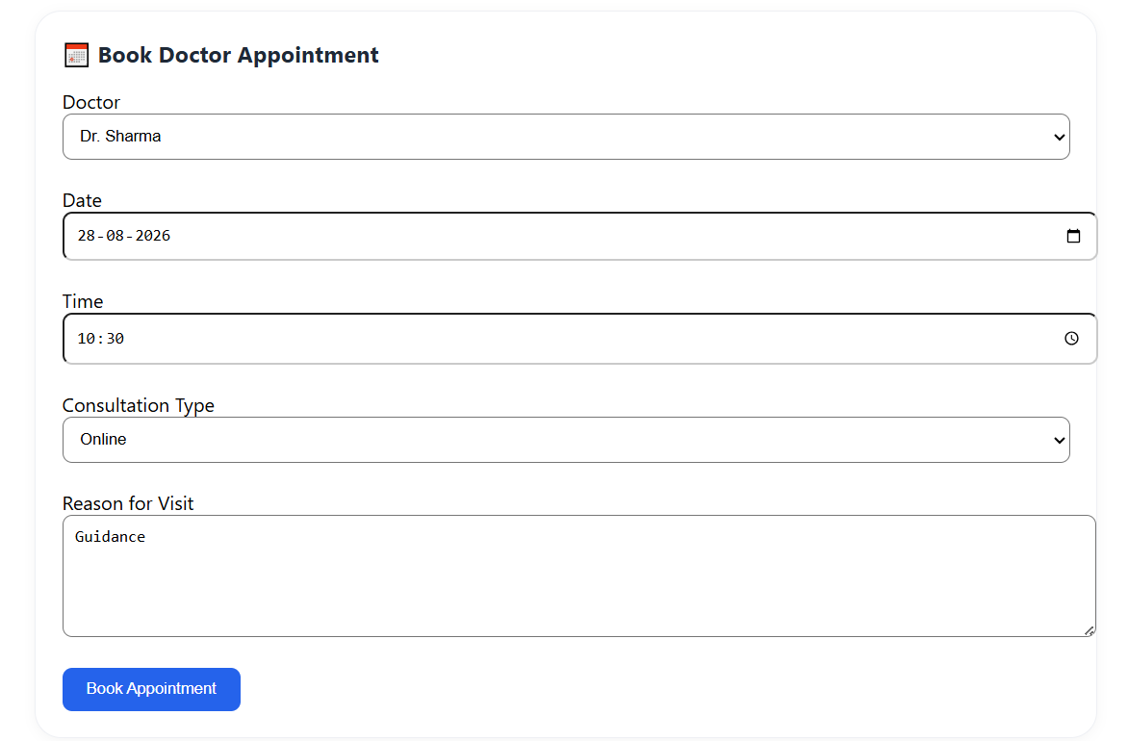

Slide 5
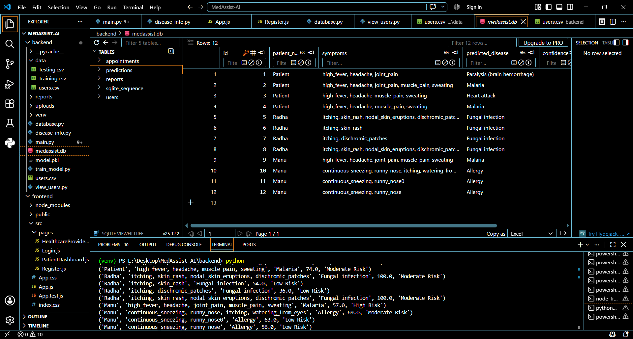
Predictions Saved in the Database

Slide 6
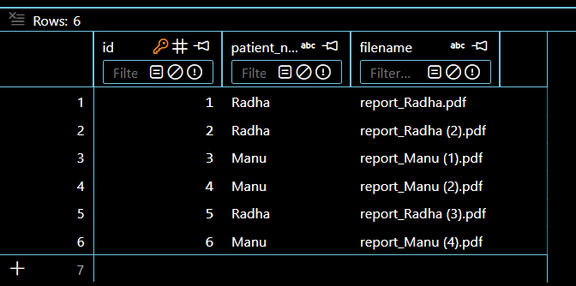
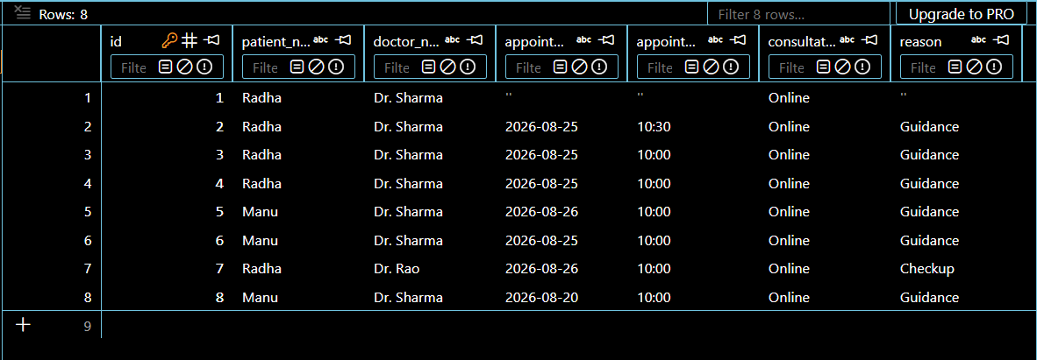
Reports & Appointments Saved in the Database

Slide 7
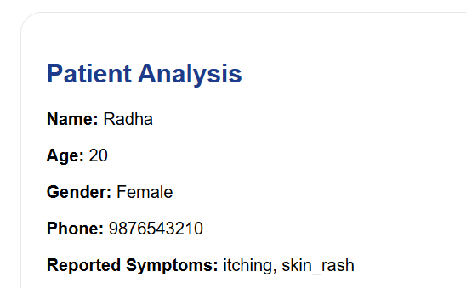
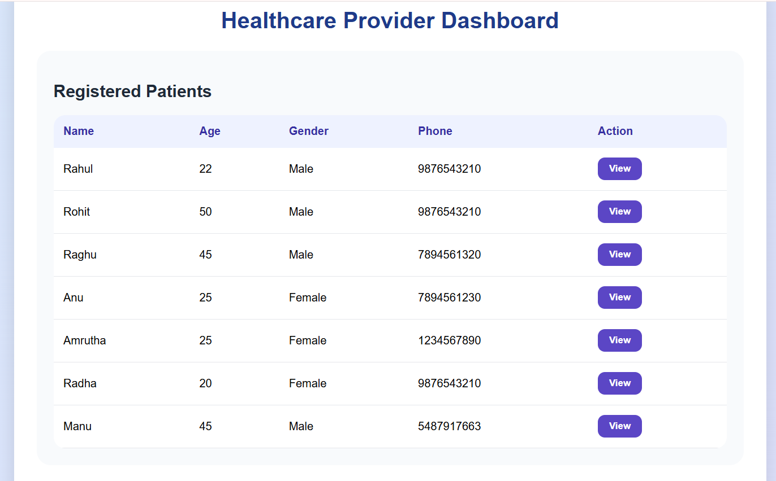
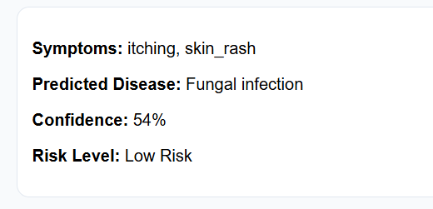
Healthcare Provider Dashboard

Slide 8
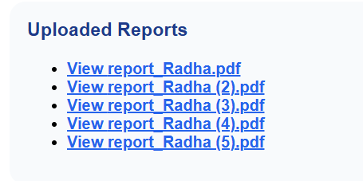
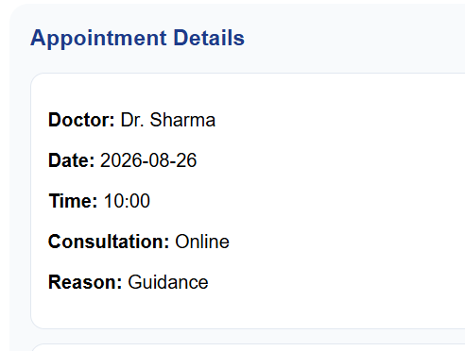
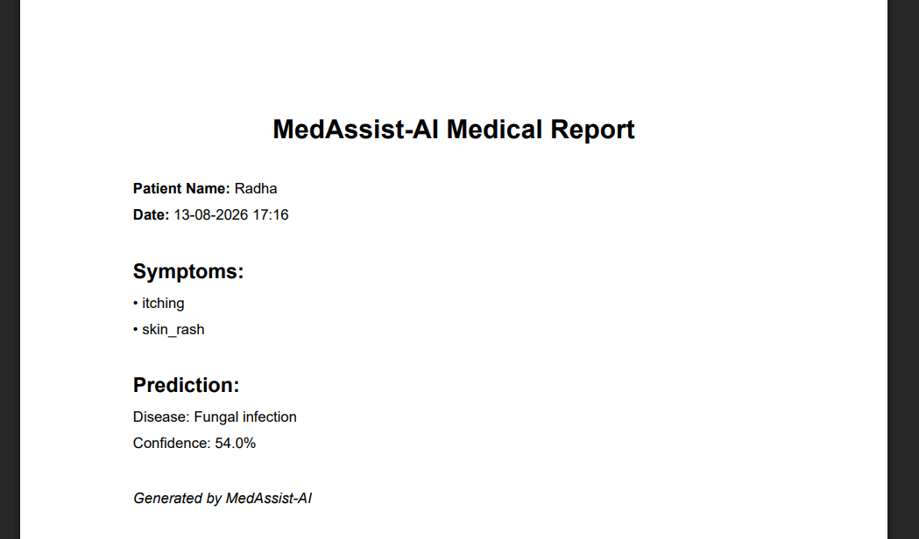

Slide 9
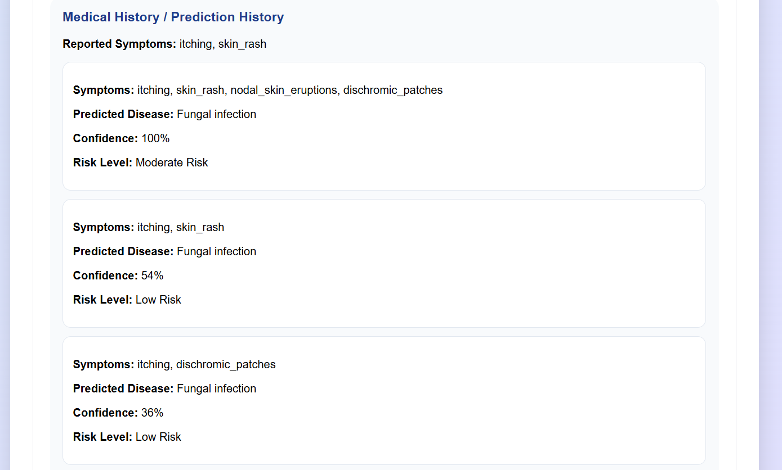
Medical History
This is a powerful tool in public speaking. It involves varying pitch, tone, and volume to convey emotion, emphasize points, and maintain interest:
  Pitch variation
  Tone inflection
  Volume control

Slide 10
THANK YOU

